Slide 1

Startup Weekend Aix-Marseille
October, 28-31th, 2016

Slide 2
Tools
Arduino IDE
Based on Processing (Java) + ARM GCC
Application based on Arduino API + libraries
Atmel Studio
Based on Microsoft Visual Studio CLI + ARM GCC
Application based on Atmel Software Framework
Available base kits in Arduino context
AVR ATMEGA328P Xplained mini
SAMD21 Xplained Pro + Xplained extensions
SAMW25 Xplained Pro + Xplained extensions
Available base kits in Atmel Studio context
SAMD21 Xplained Pro + Xplained extensions
SAMW25 Xplained Pro + Xplained extensions
SAM4E Xplained Pro + Xplained extensions

Slide 3
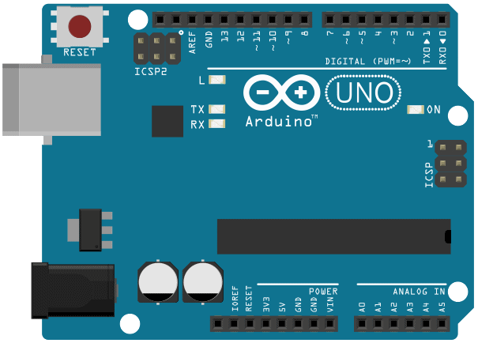
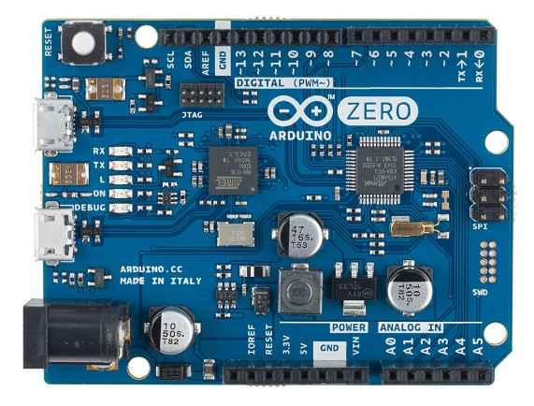
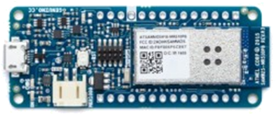
Kits usable with Arduino IDE
The following kit descriptions correspond to their use in Arduino IDE context.
The AVR ATMEGA328P Xplained mini is pin to pin compatible with Arduino Uno, thus benefits of all efforts done on this platform. The Board Support Package (BSP) is provided through the Arduino IDE Boards Manager and available on Arduino servers.
The SAMD21 Xplained Pro and SAMW25 Xplained Pro are respectively software compatible with Arduino Zero and MKR1000. They share a BSP available on Github which needs to be manually installed, as explained in the repository Wiki companion.

Slide 4
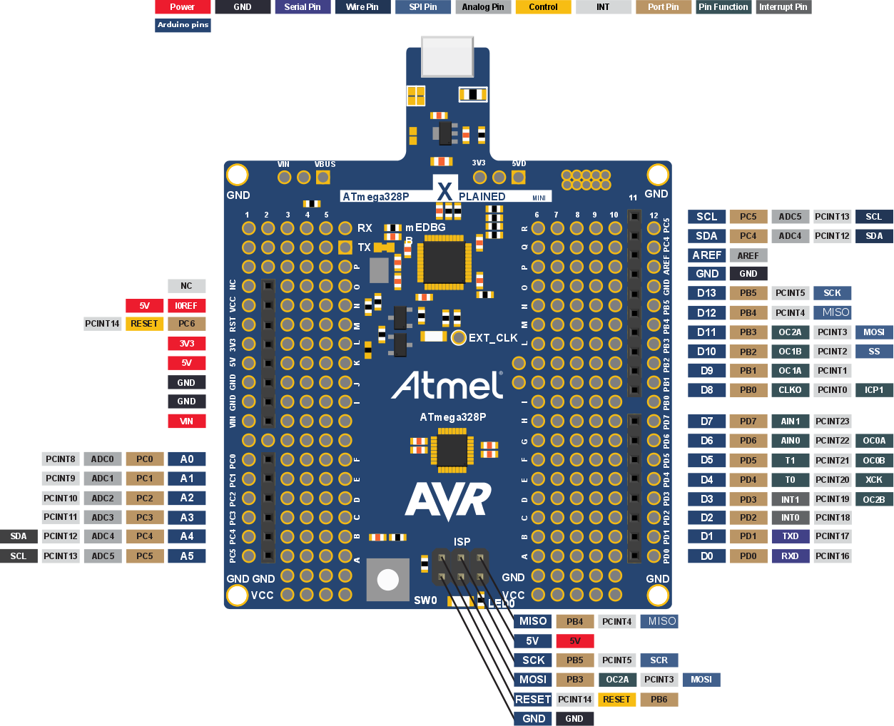
AVR atmega328p Xplained mini
Arduino pinout view

Slide 5
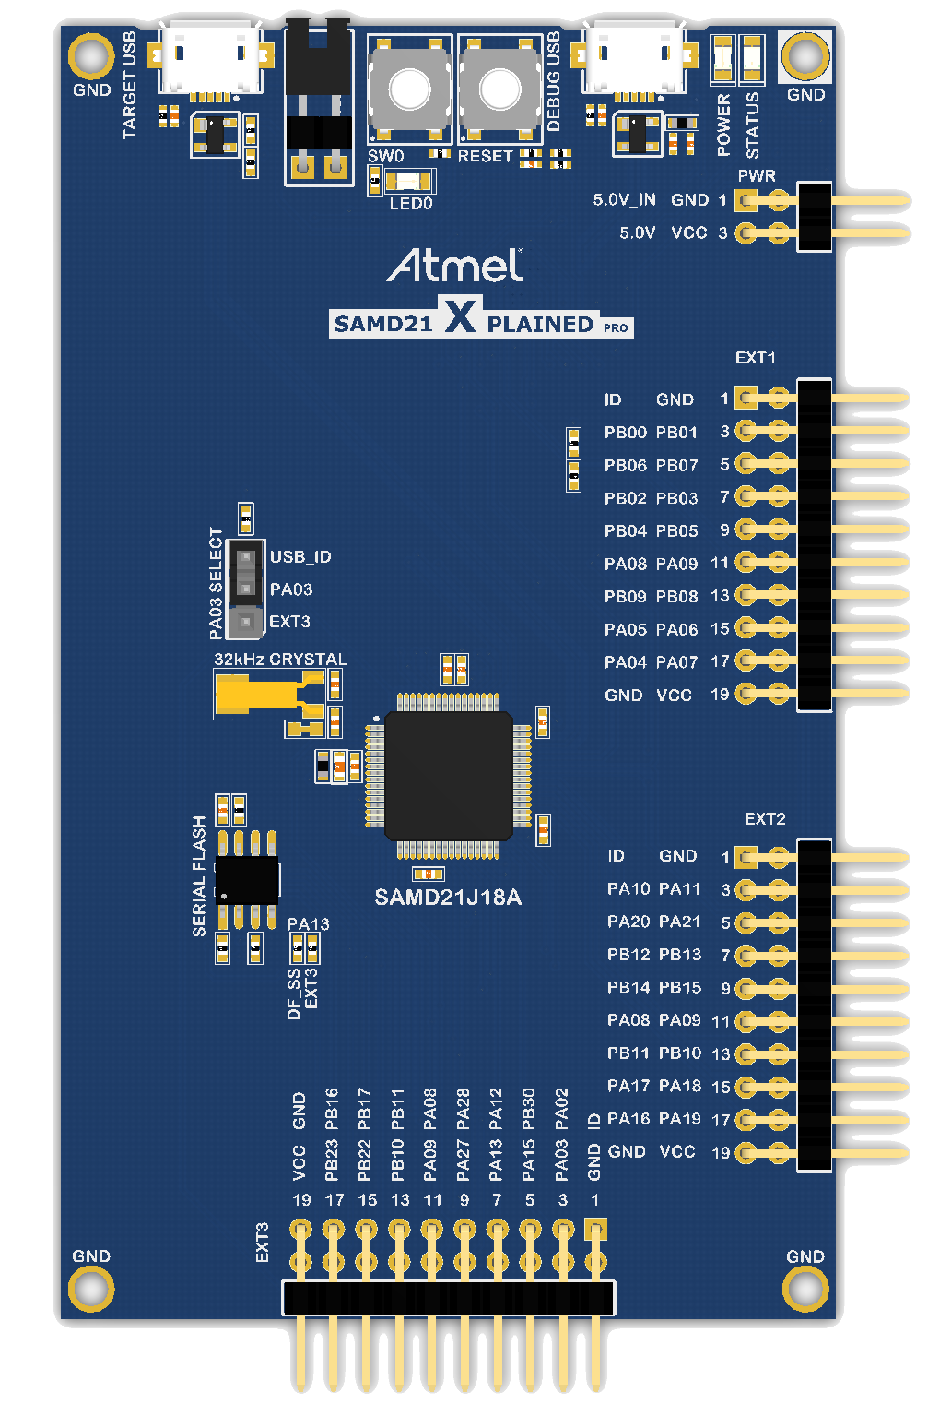
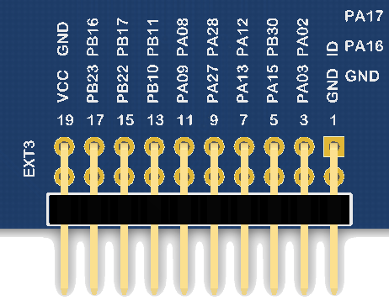
SAMD21 Xplained Pro
Arduino pinout view
SW0 is D3
Serial on Embedded Debugger
LED0 is D2
D4
A0
D5
A1
D6
D16
D7
D17
Ser1/RX
Wire/SDA
Ser1/TX
Wire/SCL
D12
A4
D13
A5
SPI/SS
SPI/SCK
SPI/MOSI
D20
D21
SPI/MISO
D14
Wire/SDA
D15
Wire/SCL
Ser2/RX
SPI2/SS
Ser2/TX
SPI2/MOSI
SPI2/MISO
SPI2/SCK
A2
D8
D9
A3
D10
D18
D11
D19
Ser2/RX
Wire/SDA
Ser2/TX
Wire/SCL
SPI1/MISO
SPI1/SS
SPI1/SCK
SPI1/MOSI
Arduino pins D2-D15 are pure GPIO. D16-D21 are GPIO and PWM.

Slide 6
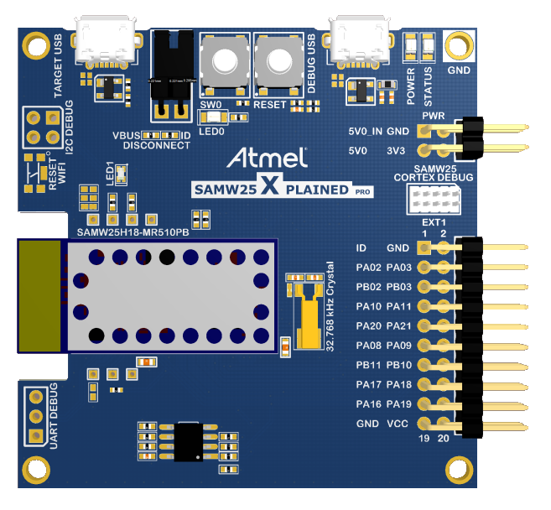
SAMW25 Xplained Pro
Arduino pinout view
SW0 is D3
Serial on Embedded Debugger
LED0 is D2
D4
A0
D5
A1
WiFi on SPI1
D8
D9
D6
Wire/SDA
D7
Wire/SCL
Serial1
SPI
Serial1
SPI
SPI
SPI
Arduino pins D2-D7 are pure GPIO. D8-D9 are GPIO and PWM.
Notes:
Pinout ref: https://github.com/AtmelUniversityFrance/atmel-samd21-xpro-boardmanagermodule/blob/master/module/variants/atmel_samw25_xpro/variant.cpp

Slide 7
Kits usable with Atmel Studio
Atmel Xplained Pro platform
The following kit descriptions correspond to their use in usual industrial context.
These kits are usually used in a product evaluation context and even if their design is a working one, they shouldn’t be considered as reference design.
The Xplained Pro platform is an Atmel ecosystem gathering the kits hardware, the according documentation and as much as possible software examples.
Basic or applicative applications are made available through Atmel Software Framework (ASF). ASF is preferred used with the free Atmel Studio but also with any other development environment via its standalone delivery.
Some kits being appreciated by Open Source Community have been integrated to various projects according to their specific characteristics.

Slide 8
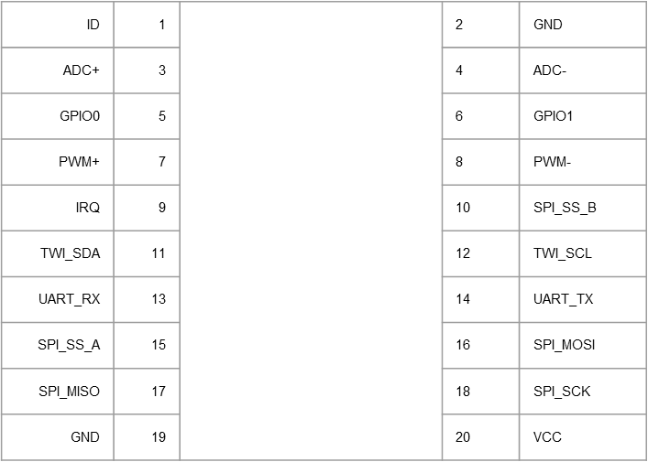
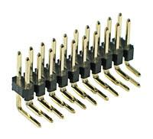
Xplained Pro Extension header pinout

Slide 9
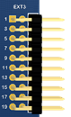
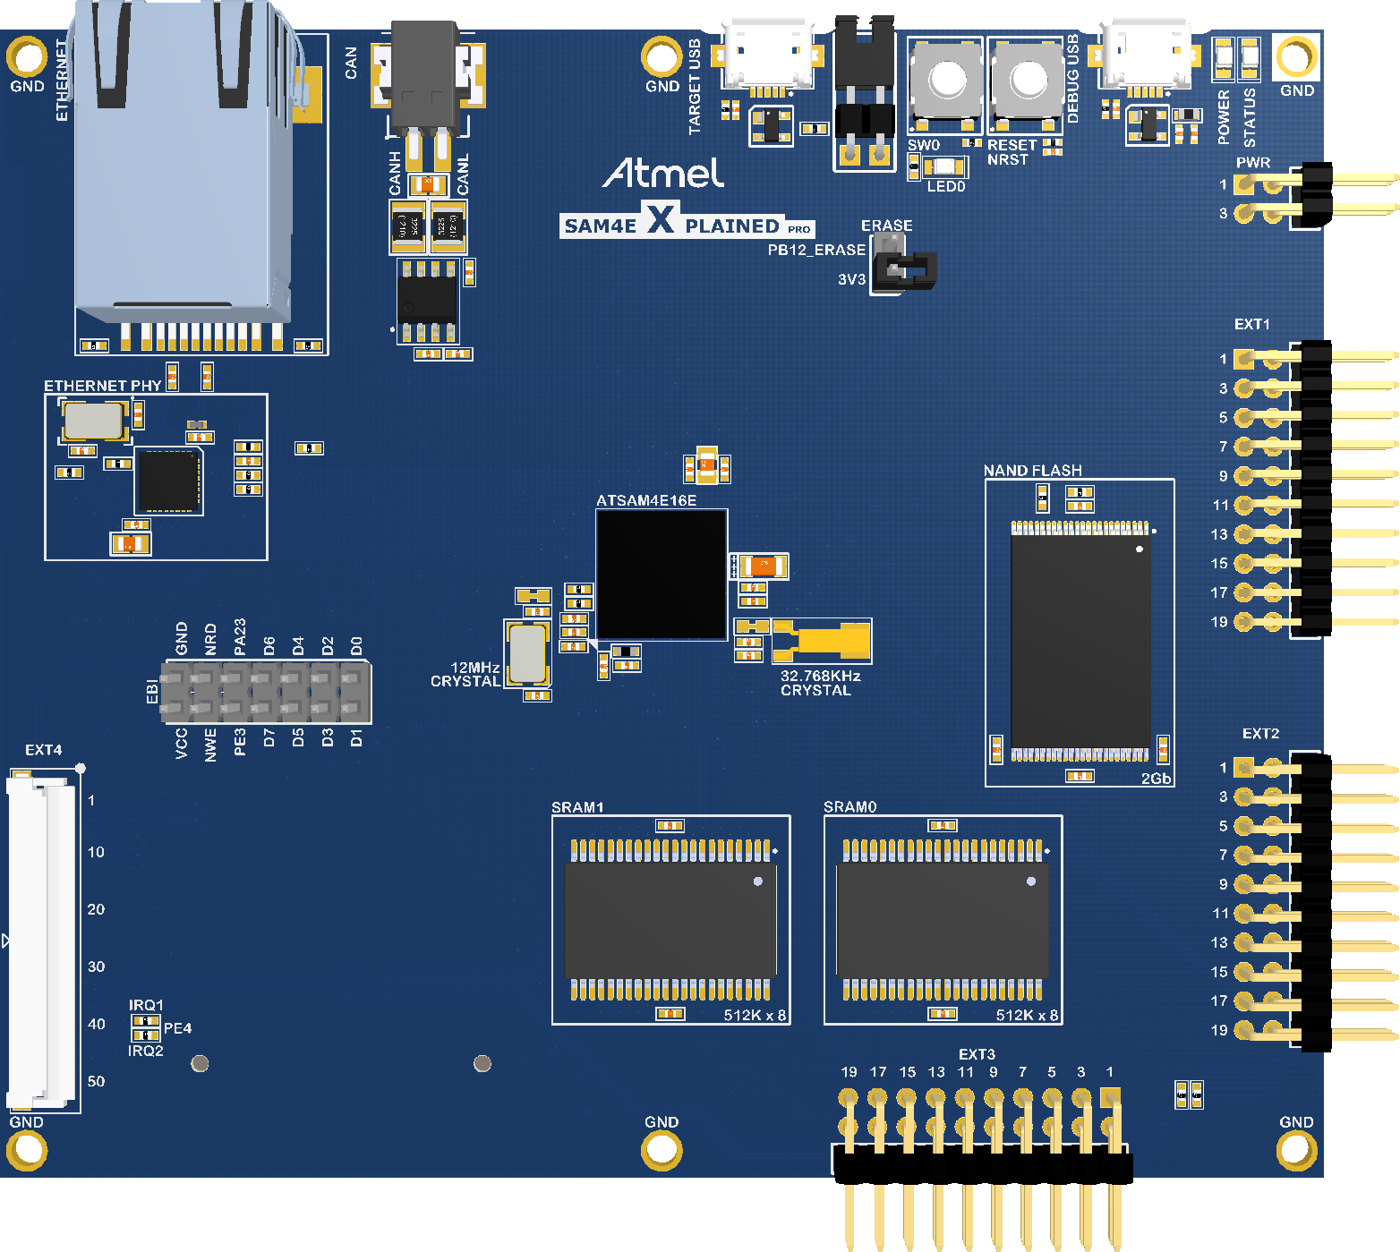
SAM4E Xplained Pro
Atmel Studio/Software Framework pinout
Ethernet
CAN
SW0
(PA02)
Embedded Debugger
GPIO0
ADC+
GPIO1
ADC-
IRQ
PWM+
SPI_SS_B
PWM-
UART_RX
TWI_SDA
UART_TX
TWI_SCL
SPI_MISO
SPI_SS_A
SPI_SCK
SPI_MOSI
GPIO0
ADC+
GPIO1
ADC-
IRQ
PWM+
SPI_SS_B
PWM-
UART_RX
TWI_SDA
UART_TX
TWI_SCL
SPI_MISO
SPI_SS_A
SPI_SCK
SPI_MOSI
2Gb
NANDFlash (EBI)
GPIO0
ADC+
GPIO1
ADC-
IRQ
PWM+
SPI_SS_B
PWM-
UART_RX
TWI_SDA
UART_TX
TWI_SCL
SPI_MISO
SPI_SS_A
SPI_SCK
SPI_MOSI
2 x 512K
SRAM (SMC)

Slide 10
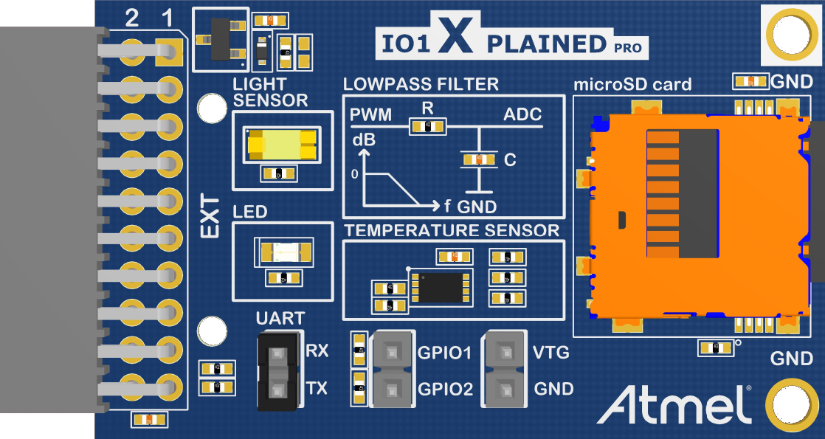
IO1 Xplained Pro
Extension pinout
1 | ID | 2 | GND
3 | Light Sensor | 4 | LP_out
5 | GPIO1 | 6 | GPIO2
7 | LED | 8 | LP_IN
9 | TEMP_ALERT | 10 | MicroSD Detect
11 | TWI_SDA | 12 | TWI_SCL
13 | UART_RX | 14 | UART_TX
15 | MicroSD SS | 16 | SPI_MOSI
17 | SPI_MISO | 18 | SPI_SCK
19 | GND | 20 | VCC
Light Sensor
Low pass filter (LP)
microSD card slot (SPI)
LED
Temperature Sensor (TWI)

Slide 11
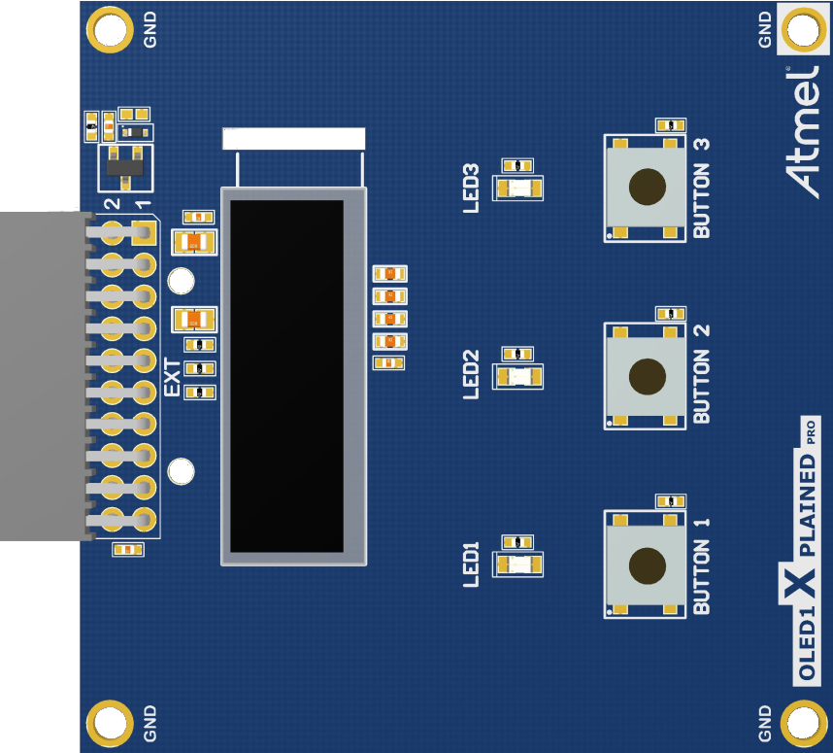
OLED1 Xplained Pro
Extension pinout
OLED Display (SPI)
LEDs
1 | ID | 2 | GND
3 | BUTTON2 | 4 | BUTTON3
5 | OLED DATA_CMD | 6 | LED3
7 | LED1 | 8 | LED2
9 | BUTTON1 | 10 | OLED RESET
11 | NC | 12 | NC
13 | NC | 14 | NC
15 | OLED SS | 16 | SPI MOSI
17 | NC | 18 | SPI SCK
19 | GND | 20 | VCC
Push Buttons

Slide 12
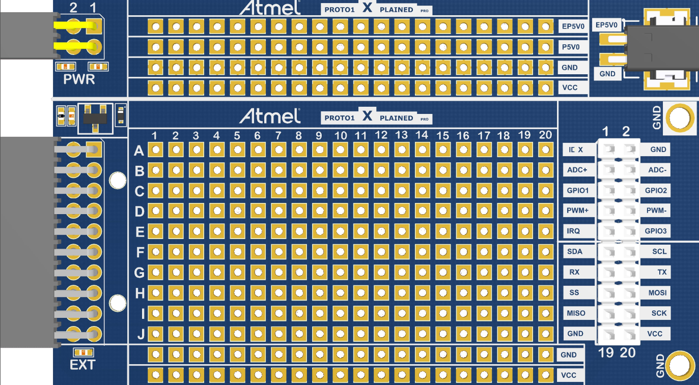
PROTO1 Xplained Pro
Extension pinout
Internal Power In/External Power Out area
Power Connector
External Power Connector
Remapped Extension Connector
Prototype Area
GND/VCC Area

Slide 13
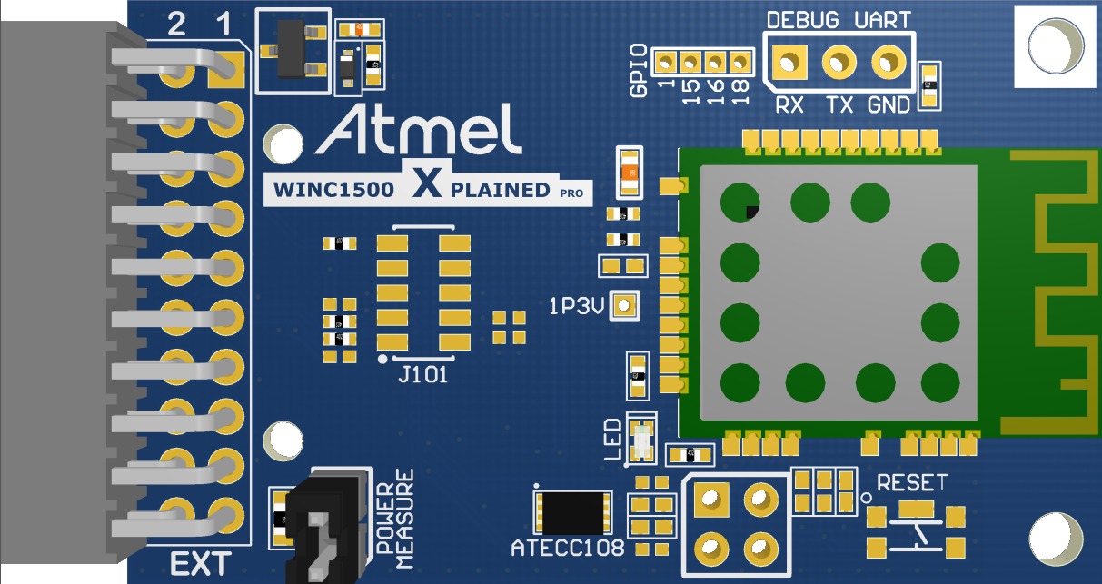
ATWINC1500 Xplained Pro
Extension pinout
1 | ID | 2 | GND
3 | NC | 4 | NC
5 | WINC1500 RESET | 6 | WINC1500 WAKE
7 | NC | 8 | NC
9 | WINC1500 IRQ | 10 | WINC1500 CHIP ENABLE
11 | I²C SDA | 12 | I²C SCL
13 | UART RX | 14 | UART TX
15 | WINC1500 SS | 16 | SPI MOSI
17 | SPI MISO | 18 | SPI SCK
19 | GND | 20 | VCC
WINC 1500 DEBUG UART
WINC 1500 Module
Power Measurment Jumper
WINC 1500 DEBUG (I²C)

Slide 14
References
Atmel Studio http://www.atmel.com/tools/atmelstudio.aspx#download
Arduino IDE https://www.arduino.cc/en/Main/Software
Atmel University France http://atmeluniversityfrance.github.io/
Atmega328p-xmini wiki https://github.com/AtmelUniversityFrance/atmel-avr-xmini-boardmanagermodule/wiki
SAMD21/W25-XPRO wiki https://github.com/AtmelUniversityFrance/atmel-samd21-xpro-boardmanagermodule/wiki

Slide 15








© 2016 Atmel Corporation.
Atmel®, Atmel logo and combinations thereof, Enabling Unlimited Possibilities®, and others are registered trademarks or trademarks of Atmel Corporation or its subsidiaries. ARM®, ARM Connected® logo and others are the registered trademarks or trademarks of ARM Ltd. Other terms and product names may be the trademarks of others.
Disclaimer: The information in this document is provided in connection with Atmel products. No license, express or implied, by estoppel or otherwise, to any intellectual property right is granted by this document or in connection with the sale of Atmel products. EXCEPT AS SET FORTH IN THE ATMEL TERMS AND CONDITIONS OF SALES LOCATED ON THE ATMEL WEBSITE, ATMEL ASSUMES NO LIABILITY WHATSOEVER AND DISCLAIMS ANY EXPRESS, IMPLIED OR STATUTORY WARRANTY RELATING TO ITS PRODUCTS INCLUDING, BUT NOT LIMITED TO, THE IMPLIED WARRANTY OF MERCHANTABILITY, FITNESS FOR A PARTICULAR PURPOSE, OR NON-INFRINGEMENT. IN NO EVENT SHALL ATMEL BE LIABLE FOR ANY DIRECT, INDIRECT, CONSEQUENTIAL, PUNITIVE, SPECIAL OR INCIDENTAL DAMAGES (INCLUDING, WITHOUT LIMITATION, DAMAGES FOR LOSS AND PROFITS, BUSINESS INTERRUPTION, OR LOSS OF INFORMATION) ARISING OUT OF THE USE OR INABILITY TO USE THIS DOCUMENT, EVEN IF ATMEL HAS BEEN ADVISED OF THE POSSIBILITY OF SUCH DAMAGES. Atmel makes no representations or warranties with respect to the accuracy or completeness of the contents of this document and reserves the right to make changes to specifications and products descriptions at any time without notice. Atmel does not make any commitment to update the information contained herein. Unless specifically provided otherwise, Atmel products are not suitable for, and shall not be used in, automotive applications. Atmel products are not intended, authorized, or warranted for use as components in applications intended to support or sustain life.

Slide 16
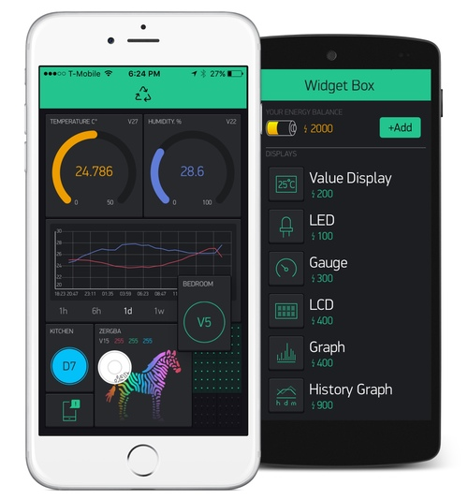
Blynk.cc
Fast application prototyping
Blynk is a Platform with iOS and Android apps to control Arduino, Raspberry Pi and the likes over the Internet.
It's a digital dashboard where you can build a graphic interface for your project by simply dragging and dropping widgets.
It's really simple to set everything up and you'll start tinkering in less than 5 mins.

Slide 17

http://atmeluniversityfrance.github.io/

Slide 18

SAMD21/W25/R21 Arduino module/BSP
https://github.com/AtmelUniversityFrance/atmel-samd21-xpro-boardmanagermodule

Slide 19

Link to this document
https://github.com/AtmelUniversityFrance/StartupWeekendAixMarseille_201610/blob/master/SWAM_october2016.pptx

